Slide 1

Summary of TC39 proposal
The proposal related to asynchronous programming

Slide 2


asynchronous programming
With the new implementation big and heavy website should now load quicker resulting in few screens being broken yearly.
When integrated into EcmaScript developers may need to spend some time learning how to use this new feature
Overall, the change should be seen as a positive change, because quicker loading time means a better experience for the end user.

Slide 3
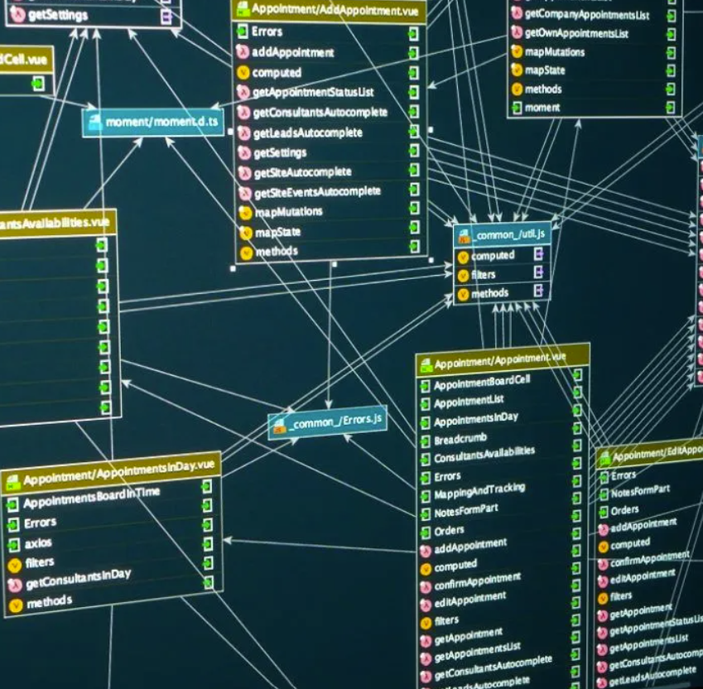
Database
Another note that I would like to add is that this new implementation could be beneficial when working with large and heavy databases, because then the program would still be able to run light tools in the browser while another process is accessing heavy data in the database for later use.

Slide 4

Thank you for watching this presentasjon
PS: This INF226 shit is wild

